Slide 1
Key research findings

Slide 2
Snapshot of data set
2 group – War survivors
group 1 well- established intervention, while group 2 limited research
Demographic variables ( gender, age, torture experienced, psychological symptoms recorded )
Notes:
1. In this study, two groups of participants were researched to evaluate the effectiveness of 2 interventions focused on addressing psychological distress among war survivors.
2. Group 1 received a well-established intervention, while Group 2 received a different intervention for which limited research had been conducted.
3. A sample size of 100 participants were selected, all war survivors, underwent psychological assessments at intake and three months after treatment
4. Additionally, demographic variables such as gender & age were recorded, along with torture experienced during war.

Slide 3
Research questions:
Is respondents’ age related to their psychological symptoms at intake?
Is respondents’ torture history related to their psychological symptoms at intake?
Did the symptoms of group 2 participants improve, on average? how would you characterize the size and significance of this group’s symptom changes?
Is there a difference in the effectiveness of interventions 1 and 2? if so, how would you characterize the difference?
Notes:
Question 1 aims to know whether there is a relationship between respondents' age and their psychological symptoms at the initial assessment
Question 2 seeks to asking the association between respondents' history of torture during conflicts and their psychological symptoms at intake. whether individuals who have experienced torture report higher levels of psychological distress compared to those who have not been tortured.
Question 3 focuses on evaluating whether there is a change in psychological symptom severity among participants in Group 2, who received a well intervention, over 3 months
Question 4 aims to compare the effectiveness of 2 interventions – to see whether there are differences or changes in psychological symptom severity between the two groups over time.

Slide 4
Key catachrestic of Research
Sample size 100
 | Group1 |  | Group2
 | Men | Women | Men | Women
Gender | 53% | 47% | 61% | 39%
torture | 12 | 15 | 23 | 15
Average Psychological Symptoms | 10.8 | 12.4 | 11.2 | 11.5
Mean | 46.7 |  | 47.3
Median | 47 |  | 47
Mode | 47 |  | 47
Notes:
1. sample size of 100 individuals provides a good representation of the population.
2. gender distribution shows differences between the two groups, with Group 2 having a higher proportion of men. The incidence of torture varies between the groups, with Group 2 reporting a higher number of incidents overall.
3. average psychological symptoms score differs slightly between genders and groups, with Group 2 generally having slightly higher scores.
4. mean, median, and mode values for both groups are very close, indicating relatively symmetric distributions. Overall, these characteristics provide insights into the demographics and key variables of the study.

Slide 5
How Data prepared for analysis?
Data preparation: Checked for any missing values or inconsistencies
Different Interventions: Group 1 & Group 2
Statistical Analysis: T-tests & correlation analysis,
Data visualization: Scatter plot & bar chart & box plot
Data interpretation
Notes:
1. Checked for any missing values or inconsistencies to ensure data quality and reliability to run analysis based on accurate and complete information.
2. Group 1 and Group 2 represent different interventions. Understanding groups data allowed me for comprising the effectiveness of the interventions
3. Utilized t-tests and correlation analysis, to see the relationships between variables. T-tests used to compare means between groups, while I used correlation analysis to assesses the strength and direction of relationships between variables.
4. Scatter plots, bar charts and box plot are utilized to visually represent the relationships and patterns identified in the data.
5. Finally, I included my interpretation. drawing conclusions, identifying trends or associations.

Slide 6
Is respondents’ age related to their psychological symptoms at intake?
Figure 1. P value: 0.1371 | No significant correlation between age and their psychological symptoms
6
6
Notes:
1. The analysis of this question revealed that there is no significant correlation between age and their psychological symptoms at intake. The correlation coefficient calculated between age and psychological symptoms was found to be approximately 0.13, indicating a near-zero correlation. This suggests that age and psychological symptoms at intake are not strongly related, and changes in one variable do not predict changes in the other.
2. To visually represent this lack of correlation, In the scatter plot, each data point represents an individual respondent, with their age plotted on the x-axis and their psychological symptoms score at intake on the y-axis. The absence of a clear trend or pattern in the data points indicates the lack of correlation between age and psychological symptoms.
3. Despite variations in age and psychological symptoms scores across respondents, there is no visible linear relationship between the two variables.
4. This finding underscores the complexity of factors influencing psychological symptoms in individuals and highlights the importance of considering multiple factors beyond age when assessing mental health outcomes.

Slide 7
2. Is respondents’ torture history related to their psychological symptoms at intake?
Figure 2: P- Value: 0.175940006 | No statistically significant difference in psychological symptom scores between individuals
Notes:
1. The results of the t-test indicate that the p-value (P(T<=t) two-tail) is 0.175940006.
2. The p-value represents the probability of observing the given difference in means between the two intervention. the p-value is greater than the typical significance level of 0.05. Therefore, I fail to reject the null hypothesis, which suggests that there is no statistically significant difference in the psychological symptom scores between individuals who experienced torture and those who did not. This means that based on the data, there is no evidence to conclude that torture history is related to psychological symptom scores at intake.

Slide 8
3. Did the symptoms of group 2 participants improve, on average? How would you characterize the size and significance of this group’s symptom changes?
Highly significant difference between the mean intake and follow-up scores for Group 2
Figure 3: P-Value: 3.68
Correlation: 5.6
Notes:
1. The average difference between intake and follow-up scores is 5.6. This suggests that, on average, participants' symptoms increased by 5.6 points from intake to follow-up. 2. The t-test result of 3.68E-13 indicates a very small p-value, which is significantly less than the typical significance level of 0.05. This suggests that there is a highly significant difference between the mean intake and follow-up scores for Group 2 participants. In other words, the change in symptoms is unlikely to be due to random chance alone. 3. The upward trend line on the scatter plot indicates that, in general, participants' follow-up scores are higher than their intake scores. This suggests that most participants experienced an increase in symptoms from intake to follow-up. 4. The significant t-test result and the upward trend line in the scatter plot indicate that, on average, participants' symptoms worsened from intake to follow-up. 5. The average increase of 5.6 points suggests a notable deterioration in symptoms over the treatment period. This finding may indicate that the intervention received by Group 2 participants was not effective in improving their psychological symptoms. 6. In summary, the analysis and scatter plot suggest that the symptoms of Group 2 participants, on average, worsened from intake to follow-up, and this change is statistically significant. Further investigation may be needed to understand why the intervention did not lead to symptom improvement.

Slide 9
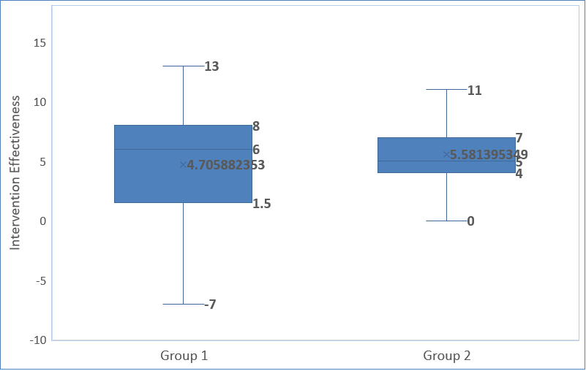
4. Is there a difference in the effectiveness of interventions 1 and 2? If so, how would you characterize the difference?
Do not have sufficient evidence to conclude that there is a statistically significant difference between scores of Group 1 and Group 2
Figure 4: P-Value: 0.2516
Notes:
A p-value of 0.2516 suggests that there is not enough evidence to reject the null hypothesis at the typical significance level of 0.05 (or 5%).
Note:
1. With a p-value greater than 0.05, we do not have sufficient evidence to conclude that there is a statistically significant difference between scores of Group 1 and Group 2.
2. This means that we cannot confidently say that the effectiveness of interventions in Group 1 is different from Group 2.
Characterizing the difference:
3. Since the p-value is not significant, it indicates that any observed differences between the two groups may likely be due to random variability rather than a true difference in the effectiveness of the interventions.
4. In other words, the interventions in Group 1 and Group 2 may have similar effects on the psychological symptoms scores, as there is no evidence to suggest otherwise based on this analysis.
Overall, based on this result, it seems that there is no significant difference in the effectiveness of interventions between Group 1 and Group 2.
To add on:
Based on the box plot and descriptive statistics, while the median effectiveness score for Group 1 (6) is slightly higher than that of Group 2 (5), the difference is not substantial.
Additionally, the averages for Group 1 (4.71) and Group 2 (5.58) are relatively close.
The interquartile range for both groups overlaps, suggesting that the variability in effectiveness scores within each group is similar.
Overall, the box plot and descriptive statistics indicate that while there may be some differences in effectiveness between interventions 1 and 2, these differences are not statistically significant.
However, further analysis may be needed to confirm this finding.

Slide 10
What statistical procedures/tests did you run and why?
Recap:
Q1. Age is related to their psychological symptoms at intake? Used correlation analysis – a
Assessed the strength and direction of the relationship between age and psychological symptoms. Visualized with a scatter plot chart to show patterns or trends.
Q2. Torture history is related to their psychological symptoms? Again, used correlation analysis - Assessed the relationship between torture history and psychological symptoms. Utilized bar chart to compare the average between psychological symptom scores and history of torture.
Q3. Symptoms of group 2 participants improved on average? Used t-test. Compared the average psychological symptom scores at intake and FUP for group 2 participants. Utilized correlation analysis and visualized with a scatter plot.
Q4. Difference in the effectiveness of interventions 1 and 2 ? Used t-test - Compared the mean psychological symptom scores between the two intervention groups, utilized a box plot to visualize descriptive analysis

Slide 11
Are there any limitations of the study that the team should consider when interpreting these results? Please explain.
Sample Size
Sampling Bias
Missing Data
Missing other key factors
Interventions
Short Follow-Up Period
Notes:
1. The study sample size may be relatively small, limiting the generalizability of the findings to broader populations of war survivors.
2. The study sample may not be entirely representative of all war survivors, as it includes only those who sought treatment. This could introduce selection bias.
3. We may consider different factors, data collection protocol, enumerator training and data entry etc.
4. Dataset does not include information on potential other factors such as participants' socioeconomic status, education level, or pre-existing medical conditions
Interventions: Group 1 received a well-established intervention supported by evidence from past clinical trials, while Group 2 received a new intervention for which limited research had been conducted.
5. The follow-up period of three months may be insufficient to capture long-term changes in psychological symptoms or the sustained effects of the interventions. Longer follow-up periods would provide a more comprehensive understanding of intervention outcomes over time.
Future research with a larger sample size, more complete data, and a broader scope of analysis would help address some of these limitations and provide a more comprehensive understanding of the research questions.

Slide 12


